Slide 1
Principal Component Analysis and Singular Value Decomposition
Dr. Pradeep Bilurkar
Notes:
This template can be used as a starter file for presenting training materials in a group setting.
Sections
Right-click on a slide to add sections. Sections can help to organize your slides or facilitate collaboration between multiple authors.
Notes
Use the Notes section for delivery notes or to provide additional details for the audience. View these notes in Presentation View during your presentation.
Keep in mind the font size (important for accessibility, visibility, videotaping, and online production)
Coordinated colors
Pay particular attention to the graphs, charts, and text boxes.
Consider that attendees will print in black and white or grayscale. Run a test print to make sure your colors work when printed in pure black and white and grayscale.
Graphics, tables, and graphs
Keep it simple: If possible, use consistent, non-distracting styles and colors.
Label all graphs and tables.

Slide 2
Principle Component Analysis-
Introduction to mathematical concepts that will be used in PCA and SVD. It covers standard deviation, covariance, eigenvectors and eigenvalues, matrix diagonalization.
Understanding of Principal Components Analysis (PCA)/SVD
Applications/Usage of both the techniques.

Slide 3
Statistics Basics
The science of collectiong, organizing, presenting, analyzing, and interpreting data to assist in making more effective decisions
Statisticians are usually concerned with taking a sample of a population. To use election polls as an example, the population is all the people in the country, whereas a sample is a subset of the population that the statisticians measure. The great thing about statistics is that by only measuring (in this case by doing a phone survey or similar) a sample of the population, you can work out what is most likely to be the measurement if you used the entire population.
X=[1,2,4,6,12,15,25,45,68,67,65,98]

Slide 4
Types of statistics
Descriptive statistics – Methods of organizing, summarizing, and presenting data in an informative way
Inferential statistics – The methods used to determine something about a population on the basis of a sample
Population –The entire set of individuals or objects of interest or the measurements obtained from all individuals or objects of interest
Sample – A portion, or part, of the population of interest

Slide 5
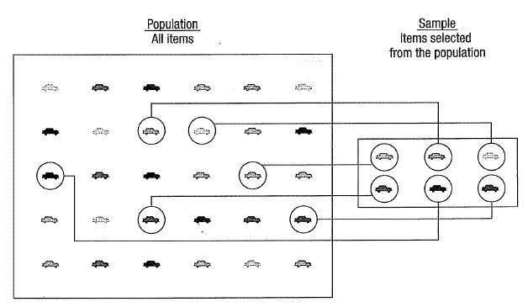

Slide 6
Inferential Statistics
Estimation
e.g., Estimate the population mean weight using the sample mean weight
Hypothesis testing
e.g., Test the claim that the population mean weight is 70 kg
Inference is the process of drawing conclusions or making decisions about a population based on sample results

Slide 7
Sampling
a sample should have the same characteristics
as the population it is representing.
Sampling can be:
with replacement: a member of the population may be chosen more than once (picking the candy from the bowl)
without replacement: a member of the population may be chosen only once (lottery ticket)

Slide 8
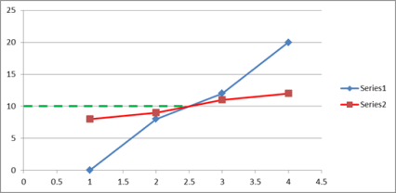
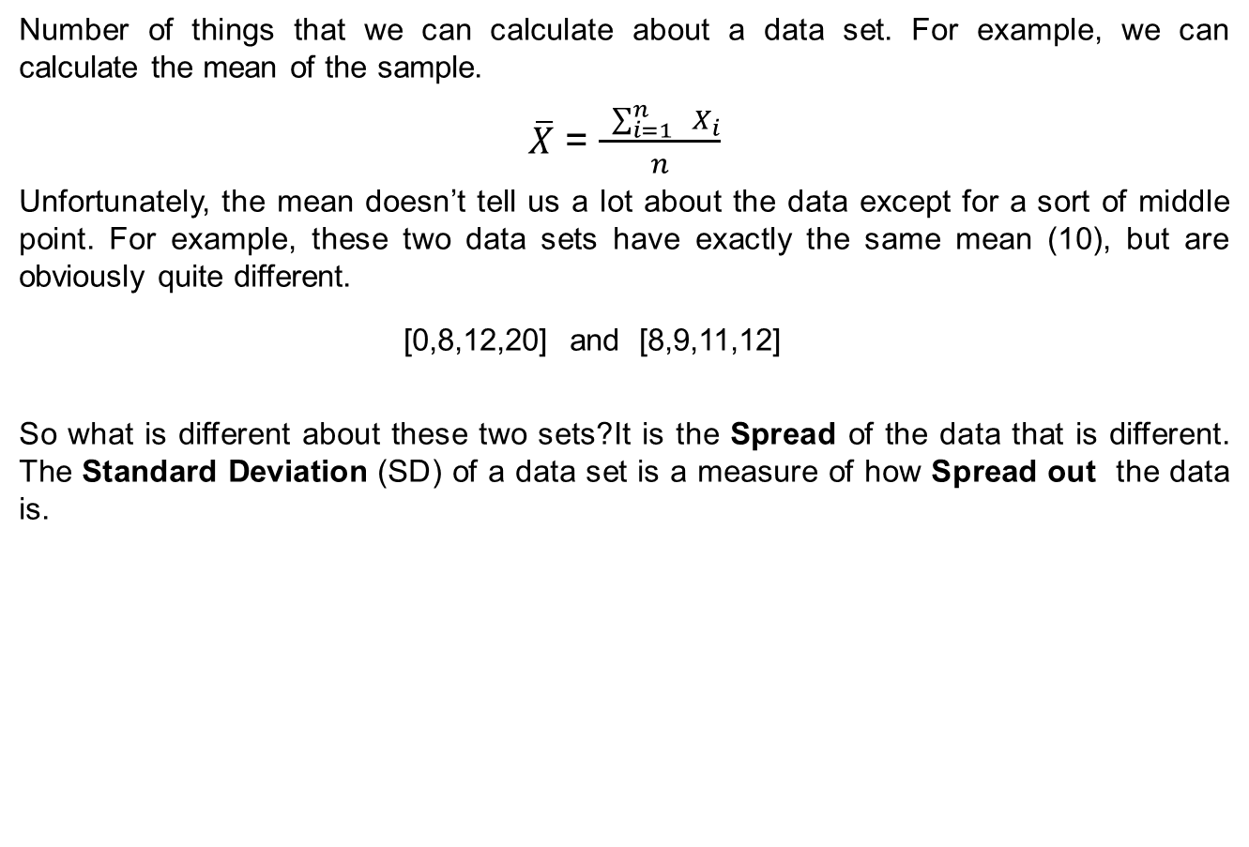
Mean or Average
Number of things that we can calculate about a data set. For example, we can calculate the mean of the sample.
$\overline{X}$ = $\frac{ \sum_{i=1}^{n}{{ X}_{i}}}{n}$
Unfortunately, the mean doesn’t tell us a lot about the data except for a sort of middle point. For example, these two data sets have exactly the same mean (10), but are obviously quite different.
[0,8,12,20] and [8,9,11,12]
So what is different about these two sets?It is the Spread of the data that is different. The Standard Deviation (SD) of a data set is a measure of how Spread out the data is.

Slide 9

Standard Deviation
How do we calculate it? The English definition of the SD is: “The average distance from the mean of the data set to a point”.
S = $\sqrt{\frac{{ \sum_{i=1}^{n}{(x_{i}−\overline{x}})}^{2}}{n−1}}$ = $\sqrt{\frac{{ \sum_{i=1}^{n}{(x_{i}−\overline{x}})}^{}(x_{i}−\overline{x})}{n−1}}$
If, you are not calculating the standard deviation for a sample, but for an entire population, then you should divide by n instead of (n - 1)

Slide 10
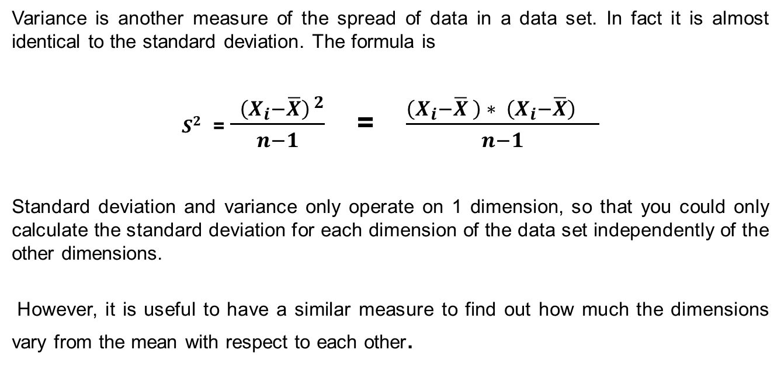
Variance
Variance is another measure of the spread of data in a data set. In fact it is almost identical to the standard deviation. The formula is
$S^{2}$ = $\frac{{ \left(X_{i}−\overline{X}\right)}^{ 2}}{n−1}$ = $\frac{{\left(X_{i}−\overline{X} \right) ∗ \left(X_{i}−\overline{X}\right)}^{ }}{n−1}$
Standard deviation and variance only operate on 1 dimension, so that you could only calculate the standard deviation for each dimension of the data set independently of the other dimensions.
However, it is useful to have a similar measure to find out how much the dimensions vary from the mean with respect to each other.

Slide 11
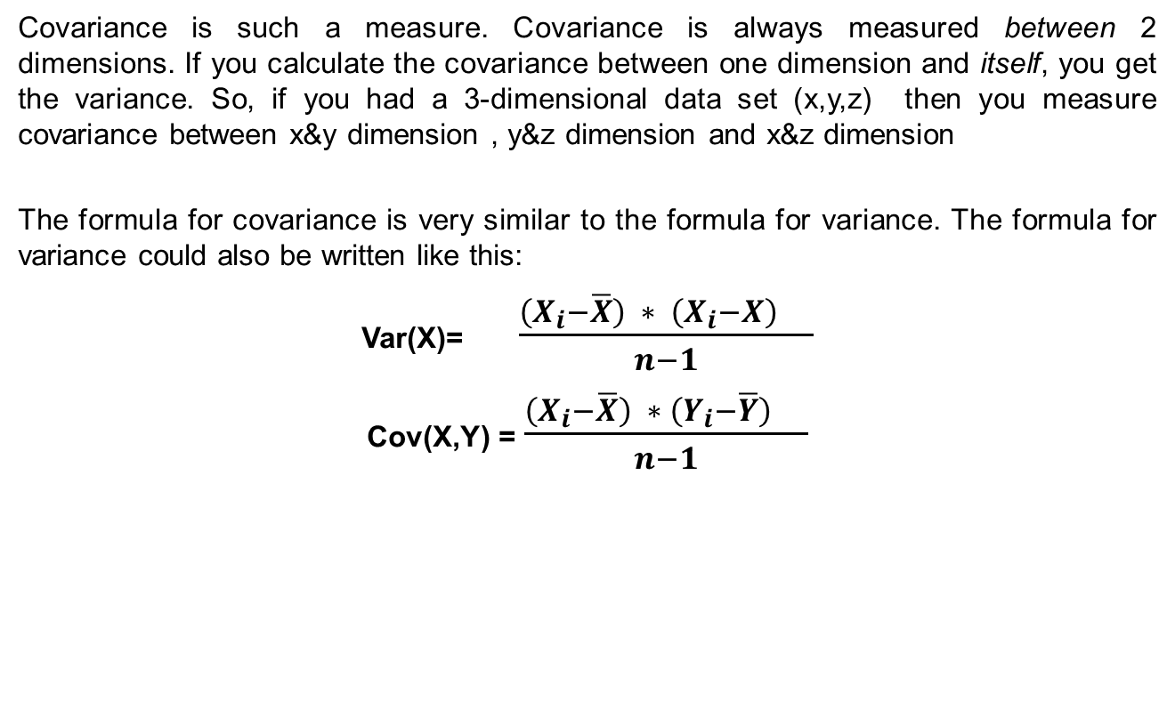
Covariance
Covariance is such a measure. Covariance is always measured between 2 dimensions. If you calculate the covariance between one dimension and itself, you get the variance. So, if you had a 3-dimensional data set (x,y,z) then you measure covariance between x&y dimension , y&z dimension and x&z dimension
The formula for covariance is very similar to the formula for variance. The formula for variance could also be written like this:
Var(X)= $\frac{{\left(X_{i}−\overline{X}\right) ∗ \left(X_{i}−X\right)}^{ }}{n−1}$
Cov(X,Y) = $\frac{{\left(X_{i}−\overline{X}\right) ∗ \left(Y_{i}−\overline{Y}\right)}^{ }}{n−1}$

Slide 12
Covariance
Imagine we have gone into the world and collected some 2-dimensional data, say, we have asked a bunch of students how many hours in total that they spent studying PHY-241, and the mark that they received. So we have two dimensions, the first is the say H dimension, the hours studied, and the second dimension M , the mark received.
H=[6,4,8,2,1,3,5,10]
M= [58, 38, 76, 18, 10, 34, 55, 90]
cov(H,M) = 83.34
If Marks obtained are, if H is now no of hours put in for non curricular activities.
H=[6,4,8,2,1,3,5,10]
M =[10,76,90,55,58,38,18, 30]
cov(H,M) = - 33.70

Slide 13
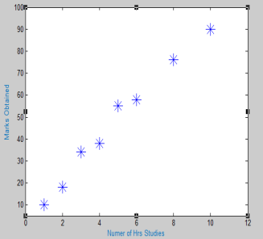
Marks Vs No of Hours of Study Data
cov=83.34

Slide 14
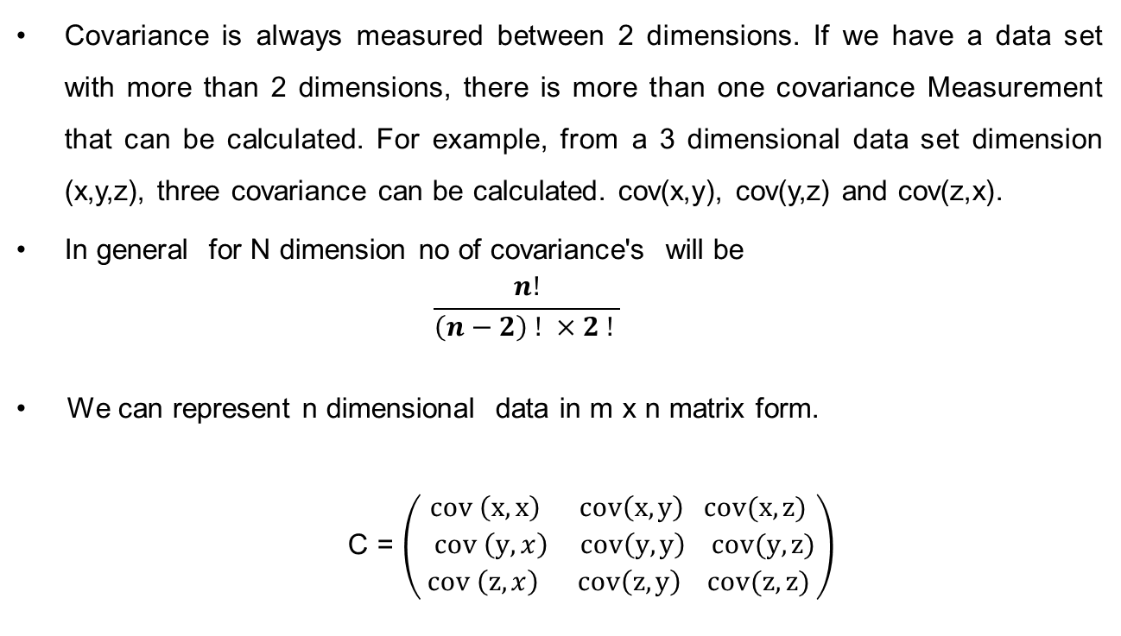
Covariance of Matrix
Covariance is always measured between 2 dimensions. If we have a data set with more than 2 dimensions, there is more than one covariance Measurement that can be calculated. For example, from a 3 dimensional data set dimension (x,y,z), three covariance can be calculated. cov(x,y), cov(y,z) and cov(z,x).
In general for N dimension no of covariance's will be
$$\frac{n!}{\left(n−2\right) ! ×2 ! }$$
We can represent n dimensional data in m x n matrix form.
C = $\left(\begin{aligned}cov \left(x,x\right) cov\left(x,y\right) cov(x,z) \\ cov \left(y,x\right) cov\left(y,y\right) cov(y,z) \\ cov \left(z,x\right) cov\left(z,y\right) cov(z,z)\end{aligned}\right)$

Slide 15

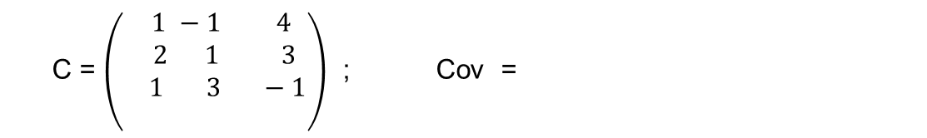
Exercise
Find covariance of following 3 dimensional set of data
Item Number | 1 | 2 | 3
x | 1 | -1 | 4
y | 2 | 1 | 3
z | 1 | 3 | -1
$$\left(\begin{aligned}\text{6.3 2.5 −5.0} \\ \text{2.5 1.0 −2.}0 \\ \text{−5.0 −2.0 4.0} \\ \end{aligned}\right)$$
C = $\left(\begin{aligned} 1 −1 4 \\ 2 1 3 \\ 1 3 −1 \\ \end{aligned}\right)$ ; Cov =

Slide 16
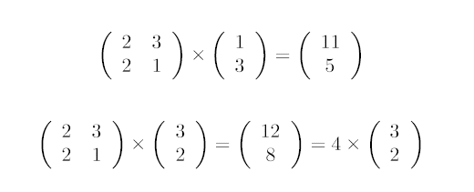
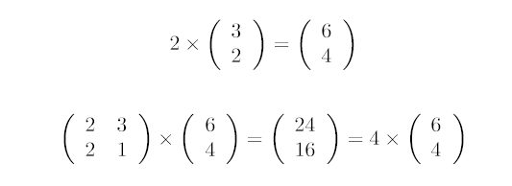
Matrix Algebra
Length of the Vectors =

Slide 17

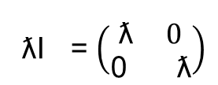
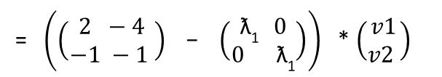
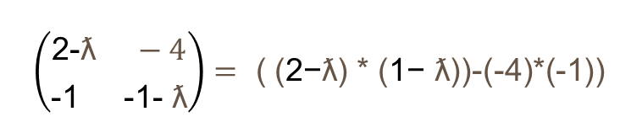




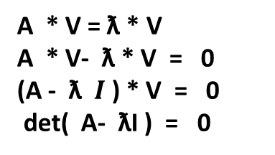


Example
A * V = $\text{ƛ}$* V
A * V- $\text{ƛ}$* V = 0
(A - $\text{ƛ} I$) * V = 0
det( A- ƛI ) = 0
A = $\left(\begin{aligned}2 −4 \\ −1 −1 \end{aligned}\right)$
I = $\left(\begin{aligned} 1 0 \\ 0 1 \end{aligned} \right)$
ƛI = $\left(\begin{aligned}\text{ƛ} 0 \\ \text{0 }\text{ƛ}\end{aligned}\right)$
$\left(\begin{aligned}\text{2−}\text{ƛ} −4 \\ \text{−1 −1− }\text{ƛ}\end{aligned}\right)=$ ( ($\text{2−}\text{ƛ}$) * ($\text{1− }\text{ƛ}$))-(-4)*(-1))
det( A- ƛI ) = 0 =>
$$= {\text{ƛ}}^{2}−\text{ƛ}−6=0 ⇒$$
$\text{ƛ}\text{1} = 3, and \text{ƛ}\text{2 }$= - 2
( A- ƛ$\text{1}$ I) * v = 0 =>
= $\left(\left(\begin{aligned}2 −4 \\ −1 −1 \end{aligned}\right) \text{ − }\left(\begin{aligned}\text{ƛ}\text{1} 0 \\ \text{0 }\text{ƛ}\text{1}\end{aligned}\right)\right)$* $\left(\begin{aligned}v1 \\ v2 \end{aligned}\right)$
$\left(\begin{aligned}(2−3) −4 \\ −1 (−1 −3)\end{aligned}\right)$ * $\left(\begin{aligned}v1 \\ v2 \end{aligned}\right)$ =0
-v₁ - 4 v₂ =0 ➔ $\left(\begin{aligned}4 \\ −1 \end{aligned}\right)$

Slide 18
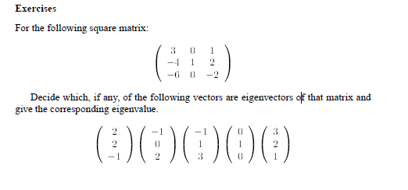
Exercise

Slide 19
Principal Component Analysis
It is a way of identifying patterns in data, and expressing the data in such a way as to highlight their similarities and differences. Since patterns in data can be hard to find in data of high dimension, where the luxury of graphical representation is not available.
The other main advantage of PCA is that once you have found these patterns in the data, you can compress the data, ie. by reducing the number of dimensions, without much loss of information. This technique used in image compression, PCA is a powerful tool for analysing data.

Slide 20
Process Steps for PCA
Step 1: Get some data
Step 2: Subtract the mean
Step 3: Calculate the covariance matrix
Step 4: Calculate the eigenvectors and eigenvalues of the covariance matrix
Step 5: Choosing components and forming a feature vector
Step 6: Deriving the new data set

Slide 21
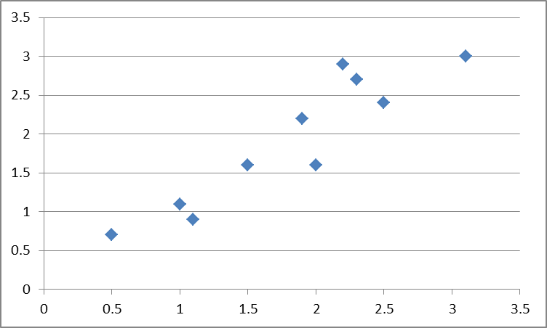
Example
 | X | Y
 | 2.5 | 2.4
 | 0.5 | 0.7
 | 2.2 | 2.9
 | 1.9 | 2.2
 | 3.1 | 3
 | 2.3 | 2.7
 | 2 | 1.6
 | 1 | 1.1
 | 1.5 | 1.6
 | 1.1 | 0.9
mean | 1.81 | 1.91
X | Y
0.69 | 0.49
-1.31 | -1.21
0.39 | 0.99
0.09 | 0.29
1.29 | 1.09
0.49 | 0.79
0.19 | -0.31
-0.81 | -0.81
-0.31 | -0.31
-0.71 | -1.01
Data
Data Adjusted

Slide 22
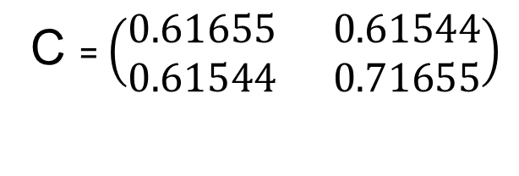
Example cont
Step 3: Calculate the covariance matrix
C = $\left(\begin{aligned}0.61655 0.61544 \\ 0.61544 0.71655\end{aligned}\right)$
So, since the non-diagonal elements in this covariance matrix are positive, we should expect that both the X and Y variable increase together

Slide 23
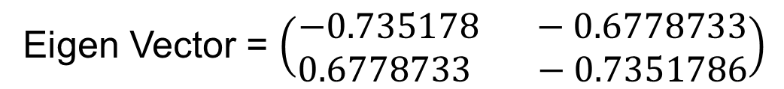
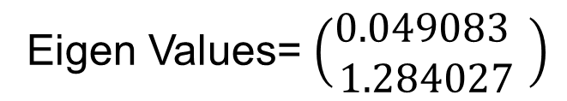
Example Cont..
Step 4: Calculate the eigenvectors and eigenvalues of the covariance matrix
Since the covariance matrix is square, we can calculate the eigenvectors and eigenvalues for this matrix.
Eigen Values= $\left(\begin{aligned}0.049083 \\ 1.284027 \end{aligned}\right)$
Eigen Vector = $\left(\begin{aligned}−0.735178 −0.6778733 \\ 0.6778733 −0.7351786\end{aligned}\right)$
It is important to notice that these eigenvectors are both unit eigenvectors ie. Their lengths are both 1.

Slide 24
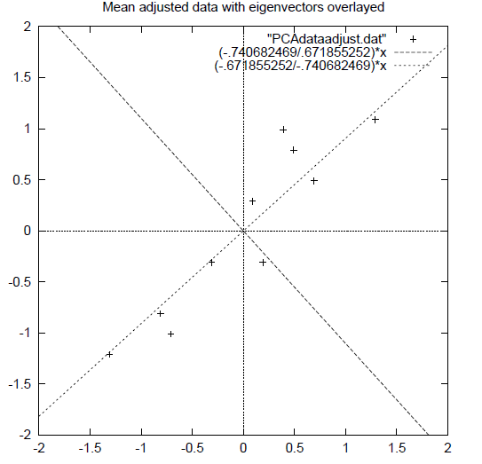
Example ……….Continued
Both the eigenvector are perpendicular to each other. But, more importantly, they provide us with information about the patterns in the data. See how one of the eigenvectors goes through the middle of the points, like drawing a line of best fit.
So, by this process of taking the eigenvectors of the covariance matrix, we have been able to extract lines that characterise the data.

Slide 25
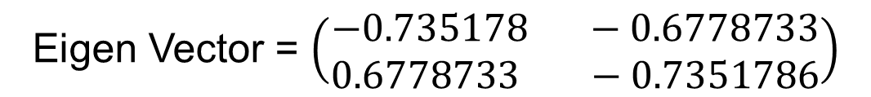
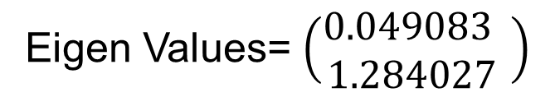
Example ……….Continued
Step 5: Choosing components and forming a feature vector
Eigen Values= $\left(\begin{aligned}0.049083 \\ 1.284027 \end{aligned}\right)$
Eigen Vector = $\left(\begin{aligned}−0.735178 −0.6778733 \\ 0.6778733 −0.7351786\end{aligned}\right)$
The eigenvector with the highest eigenvalue is the principle component of the data set.

Slide 26
Example ……….Continued
In general, once eigenvectors are found from the covariance matrix, the next step is to order them by eigenvalue, highest to lowest. This gives you the components in order of significance.
Now, if you like, you can decide to ignore the components of lesser significance.
You do lose some information, but if the eigenvalues are small, you don’t lose much.
If you leave out some components, the final data set will have less dimensions than the original.
In short if you originally have n dimensions in your data, and so you calculate n eigenvectors and eigenvalues, and then you choose only the first p eigenvectors, then the final data set has only p dimensions.

Slide 27

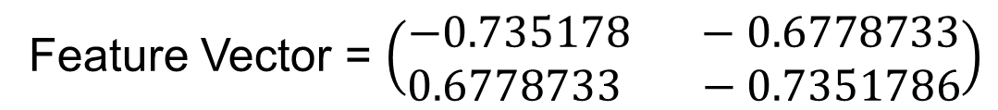
Example ……….Continued
6. To form a feature vector,
Feature vector is just a fancy name for a matrix of vectors. This is constructed by taking the eigenvectors that you want to keep from the list of eigenvectors, and forming a matrix with these eig envectors in the columns.
Feature Vector = (eig₁, eig₂, eig₃…….)
Given our example set of data, and the fact that we have 2 eigenvectors, we have two choices. We can either form a feature vector with both of the eigenvectors:
Feature Vector = $\left(\begin{aligned}−0.735178 −0.6778733 \\ 0.6778733 −0.7351786\end{aligned}\right)$
or, we can choose to leave out the smaller, less significant component and only have a single column:
Feature Vector = $\left(\begin{aligned}−0.6778733 \\ −0.7351786\end{aligned}\right)$

Slide 28
Example ……….Continued
Step 7 : Deriving the new data set
Once we have chosen the components (eigenvectors) that we wish to keep in our data and formed a feature vector, we simply take the transpose of the vector and multiply it on the left of the original data set, transposed.
Final Data = Row Feature Vector x Row Data Adjust
Where Row Feature Vector is the matrix with the eigenvectors in the columns transposed so that the eigenvectors are now in the rows, with the most significant eigenvector at the top, Row Data Adjust and is the mean-adjusted data transposed, ie. the data items are in each column, with each row holding a separate dimension
Final Data is the final data set, with data items in columns, and dimensions along rows

Slide 29
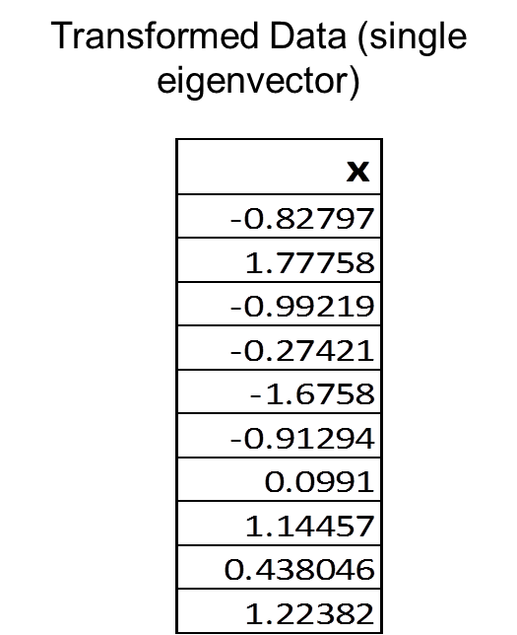
Example ……….Continued
Data Transformed with 2 eigenvectors

Slide 30
Example ……….Continued
Transformed Data (single eigenvector)

Slide 31
Example ……….Continued
Step 8 : Getting Original Data Back
How do we get the original data back? Before we do that, remember that only if we took all the eigenvectors in our transformation will we get exactly the original data back. If we have reduced the number of eigenvectors in the final transformation, then the retrieved data has lost some information.
Final Data = Row Feature Vector x Row Data Adjust
Row Data Adjust = Row Feature Vector ^{T} x Final Data
Row Data Adjust = Row Feature Vector ^{T} x Final Data + Original Mean
This formula also applies to when you do not have all the eigenvectors in the feature vector. So even when you leave out some eigenvectors, the above equation still makes the correct transform.

Slide 32
Properties of Eigenvectors
Eigenvectors can only be found for square matrices. And, not every square matrix has eigenvectors. And, given an n x n matrix if it does have Eigenvectors there will be n of them.
All the eigenvectors of a matrix are perpendicular, ie. at right angles to each other, no matter how many dimensions you have.
Another word for perpendicular, in maths talk, is orthogonal. This is important because it means that you can express the data in terms of these perpendicular eigenvectors, instead of expressing them in terms of the x and y axes.
Even if it is scaled, property of Eigenvector So, in order to keep eigenvectors standard, whenever we find an eigenvector we usually scale it to make it have a length of 1, so that all eigenvectors have the same length. does not change.

Slide 33
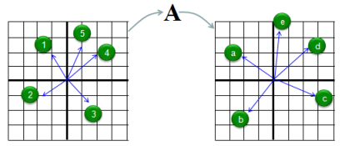
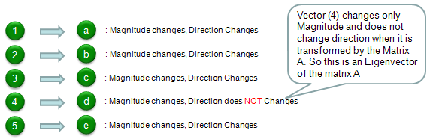
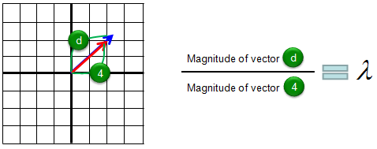

Eigen Vector ..
Eigenvectors are vectors which are fixed in direction under a given linear transformation. The scaling factor of these eigenvectors is then called the eigenvalue.
Let's assume we have a matrix called 'A'. We have 5 different vectors shown in the left side. These 5 vectors are transformed to another 5 different vectors by the matrix A as shown on the right side.

Slide 34
Usage of PCA
When you have a situation in which you have to multiply a matrix to a vector repeatedly (for example, let's assume that you have to multiply a matrix 100 times), it would require a lot of calculation. But you can predict this result just by looking at the eigenvalues without doing 100 times matrix multiplication. (You can see this kind of cases a lot in stochastics).
You can use the eigenvectors and eigenvalues to get the solution of linear differential equations
In computer graphics, a matrix is multiplied to several hundreds of points (vectors) to change the shape of an image represented by the points. By analyzing the eigenvectors of the matrix (transformation matrix), you can predict the overall result of the change of the shape without doing the several hundreds matrix x vector multiplication.

Slide 35
Matrix Diagonalization

Slide 36
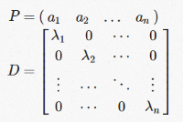

Matrix Diagonalization
A matrix A is diagonalizable if we can rewrite it (decompose it) as a product
where P is an invertible matrix (and thus P⁻¹ exists) and D is a diagonal matrix (where all off-diagonal elements are zero).
Since P is invertible, it must be square; therefore, this definition really only makes sense for square matrices.
A matrix that isn’t square is not diagonalizable, simply because the concept of diagonalization makes no sense for non-square matrices.
A = PDP−1
AND if A = PDP⁻¹, then
AP = PD.
Let’s define P through its columns a_{i} and D via its diagonal entries, as such:
Due to the way matrix multiplication works, each non-zero element in D (on the diagonal) simply picks out a different column in P and scales it.
Since AP=PD, and we can consider the columns of P separately from each other, the columns of P must be the eigenvectors of A and the values on the diagonal (D) must be eigenvalues of A.

Slide 37
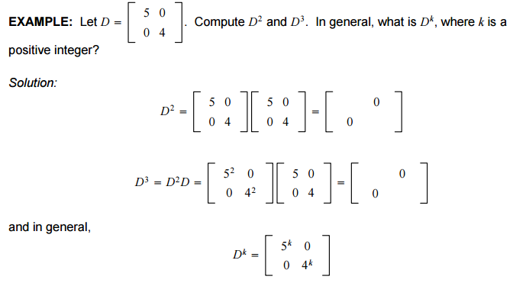

Matrix Diagonalization
We can use this to compute A^{k} quickly for large k.
The matrix D is a diagonal matrix (i.e. entries off the main diagonal are all zeros). D^{k} is trivial to compute as the following example illustrates.

Slide 38
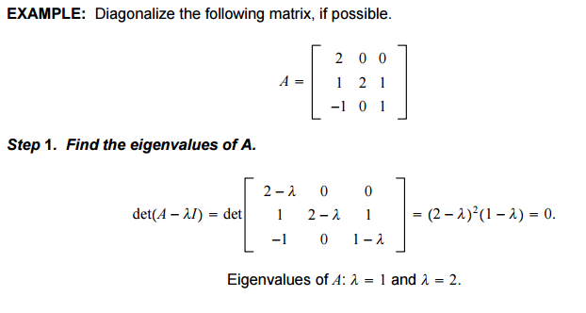
Matrix Diagonalization Example
An nx n matrix A is diagonalizable if and only if A has n linearly independent eigenvectors. In fact, A = PDP⁻¹, with D a diagonal matrix, if and only if the columns of P are n linearly independent eigenvectors of A. In this case, the diagonal entries of D are eigenvalues of A that correspond, respectively, to the eigenvectors in P.

Slide 39
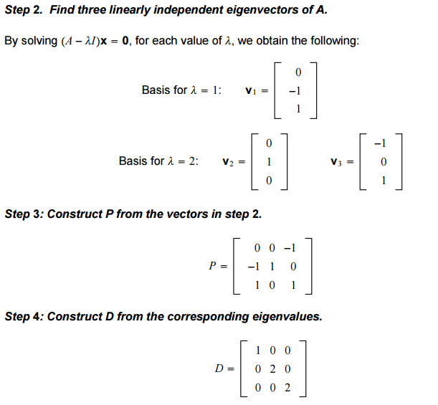
Matrix Diagonalization Example cont..

Slide 40
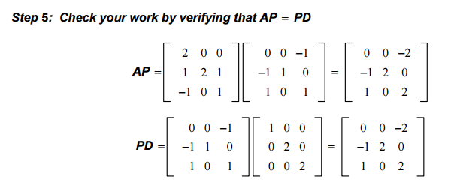
Matrix Diagonalization Example cont..

Slide 41
PCA and SVD
Consider the eigen-decomposition A=PDP⁻¹ and SVD A=UΣV∗ Some key differences are as follows,
The vectors in the eigen-decomposition matrix P are not necessarily orthogonal, so the change of basis isn't a simple rotation. On the other hand, the vectors in the matrices U and Vin the SVD are orthonormal, so they do represent rotations (and possibly flips).
In the SVD, the non diagonal matrices U and V are not necessarily the inverse of one another. They are usually not related to each other at all. In the eigen-decomposition the non diagonal matrices P and P⁻¹ are inverses of each other.
In the SVD the entries in the diagonal matrix Σ are all real and nonnegative. In the-eigen decomposition, the entries of D can be any complex number - negative, positive, imaginary, whatever.
The SVD always exists for any sort of rectangular or square matrix, whereas the eigen-decomposition can only exists for square matrices, and even among square matrices sometimes it doesn't exist.

Slide 42
SVD is based on a theorem from linear algebra which says that a rectangular matrix A can be broken down into the product of three matrices
an orthogonal matrix U,
a diagonal matrix S, and
the transpose of an orthogonal matrix V .
The theorem is usually presented something like this:

Slide 43
The SVD allows to describe the effect of a matrix on a vector (via the matrix-vector product), as a three-step process:
A first rotation in the input space
A simple positive scaling that takes a vector in the input space to the output space
And another rotation in the output space

Slide 44
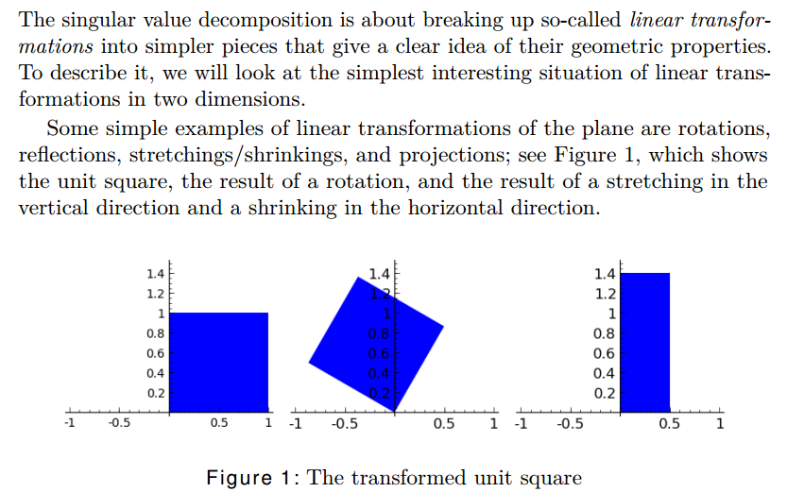

Slide 45
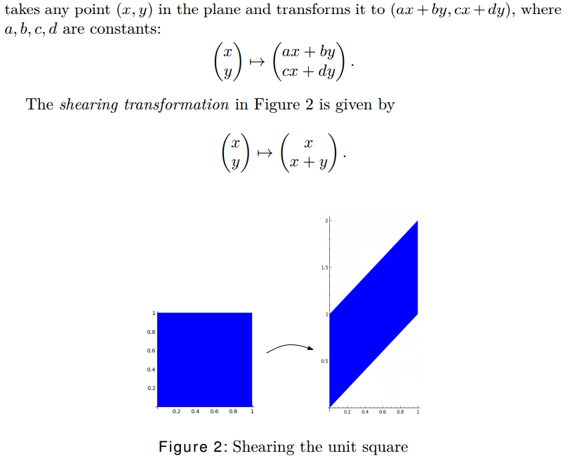

Slide 46
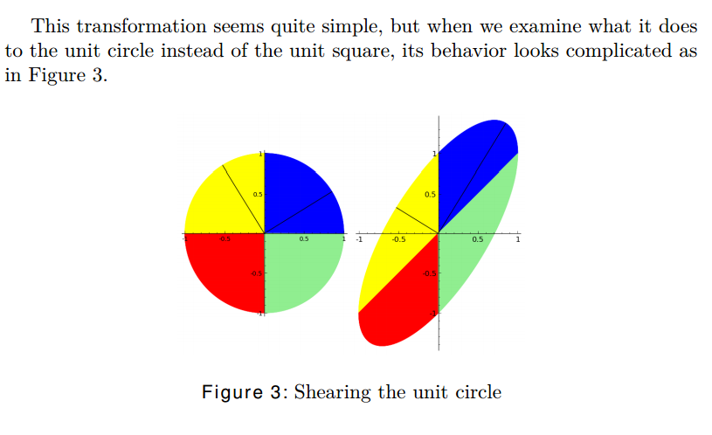

Slide 47
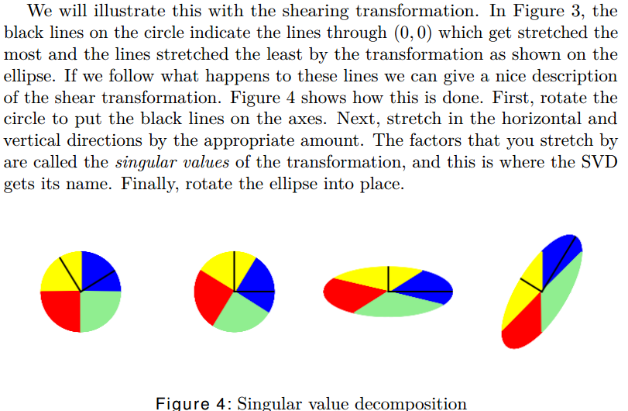

Slide 48
Singular Value Decomposition
Not all matrices are diagonalizable, since clearly not all matrices have eigenvectors that form a basis!
In some sense, the Singular Value Decomposition is essentially Diagonalization in a more general sense.
The Singular Value Decomposition plays a similar role to Diagonalization , but it fixes the flaws like; the SVD applies to matrices of any shape. Not only that, but the SVD applies to all matrices, which makes it much more generally applicable and useful than diagonalization!

Slide 49

Singular Value Decomposition
To get the singular value decomposition, we can take advantage of the fact that for any matrix A, A^{T}A is symmetric (since (A^{T}A)^{T}=A^{T}(AT)^{T}=A^{T}A(A^{T}A^{)T}=A^{T}(AT)^{T}=A^{T}A).
Symmetric matrices have the nice property that their eigenvectors form an orthonormal basis.
Since symmetric matrices have an orthonormal basis of eigenvectors, consider the eigenvectors x_{i} and corresponding eigenvalues
Let’s construct three matrices from these values:
the diagonal matrix Σ, which has σ_{i} values on the diagonal (padded with zeros if we run out of σs);
the matrix U with r_{i} as columns; and
the matrix V with x_{i}s as the columns.
(As an example, consider an A that is 500x800; then, U will be 500x500, Σ will be 500x800, with the rightmost 300 columns being just zeros, and V will be 800x800.)

Slide 50

Singular Value Decomposition
Let’s look at UΣV^{T} and perform this multiplication step-by-step.
First, start by computing UΣ; like before, the diagonal entries in Σ scale the columns of U, so we get a matrix with columns that look like
Next, we multiply UΣ by V^{T} which means we’re multiplying columns that look like Ax_{i} by rows of the form x_{j}; note that these are rows, since V has these as columns, and we’re multiplying by V^{T} .
The product contains terms that look like Ax_{i}x_{i}^{T}
however, since the x_{i}s and x_{j}s are the eigenvectors of a symmetric matrix, they form an orthonormal basis!
Distinct eigenvector dot products cancel out (due to orthogonality) and non-distinct eigenvectors simply leave the matrix A alone, because their dot product is one.
which yields that UΣV^{T}=AI=A
Thus, for any matrix A, we can rewrite it as the product A=UΣV^{T} of three matrices, U, Σ, and V^{T}, where U and V have orthonormal columns and Σ is a diagonal matrix (the entries of which are known as singular values).

Slide 51
Singular Value Decomposition
Though this may seem esoteric, the meaning of this theorem is fundamental and very interesting.
You can try to visualize it by considering what happens to the unit sphere in your vector space as it’s being transformed by the matrix A. First, we apply some transformation V^{T}, which is essentially a rotation, since it’s a matrix with orthonormal rows. (A matrix with orthonormal rows just changes the coordinate axes via some rotation or reflection but does no scaling.) Next, we apply a scaling defined by Σ, which just scales the dimensions since it’s a diagonal matrix. Finally, we rotate again with U, and we’re done! In other words, any transformation can be expressed as a rotation followed by a scaling followed by another rotation. And that’s pretty cool! Not only is it cool - it’s also thoroughly useful all over mathematics and computer science.
Note: this interpretation is specific for real square matrices, and that as soon as you start dealing with complex-valued matrices or non-square matrices this geometric interpretation loses its meaning.

Slide 52

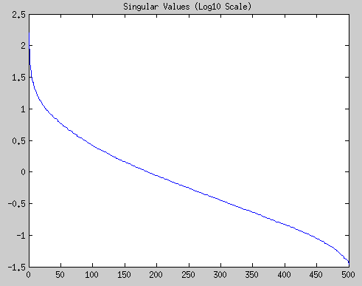
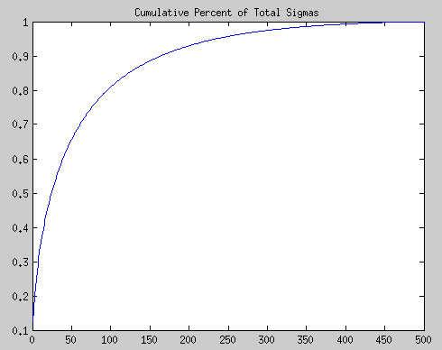
Applications: Data Compression application
We can convert this tiger to black and white, and then just treat this tiger as a matrix, where each element is the pixel intensity at the relevant location. Here are the singular values of this tiger:
Note that this is a log scale (base 10). Most of the action and the largest singular values are the first thirty or so, and they contain a majority of the “information” in this matrix! We can plot the cumulative percentage, to see how much the first thirty or fifty singular values contain of the information:
After just fifty of the singular values, we already have over 70% of the information contained in this tiger! Finally, let’s take some approximations and plot a few approximate tigers:

Slide 53
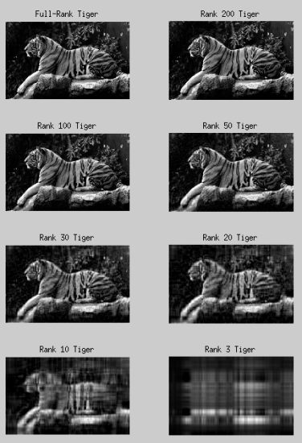
Singular Value Decomposition application
Note that after about thirty or fifty components, adding more singular values doesn’t visually seem to improve image quality.
By a quick application of SVD, you’ve just compressed a 500x800 pixel image into a 50x500 matrix (for U), 50 singular values, and a 800x50 matrix (for V).

Slide 54
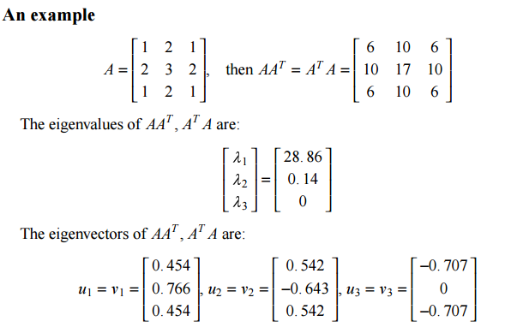
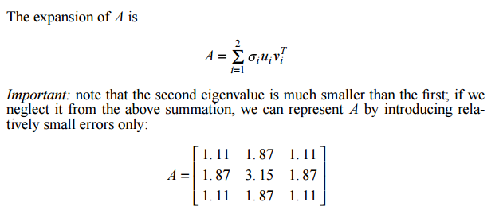
SVD application

Slide 55
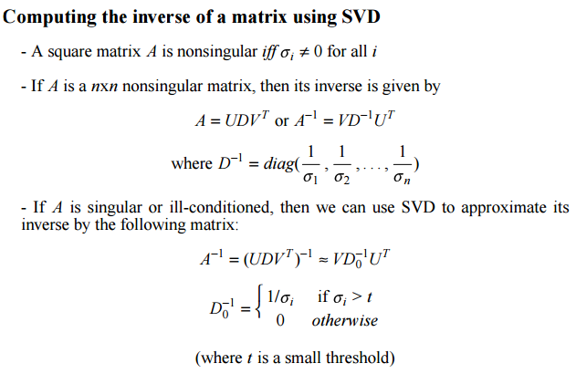
SVD application
Computing the rank using SVD –
The rank of a matrix is equal to the number of non-zero singular values.

Slide 56
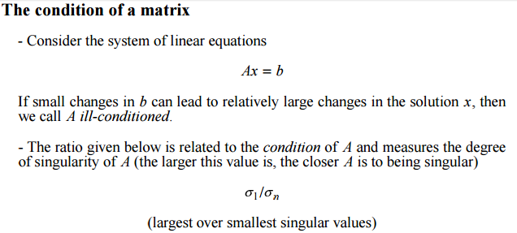
SVD application

Slide 57
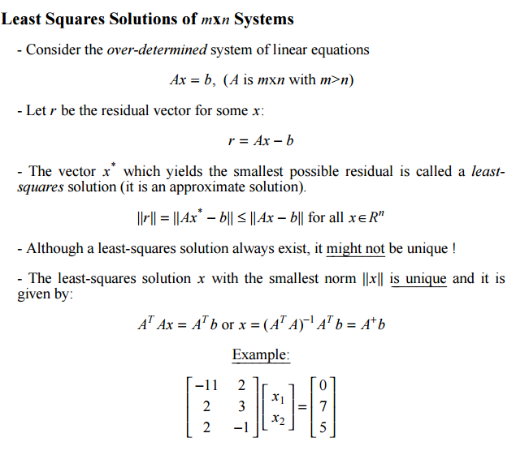
SVD application

Slide 58
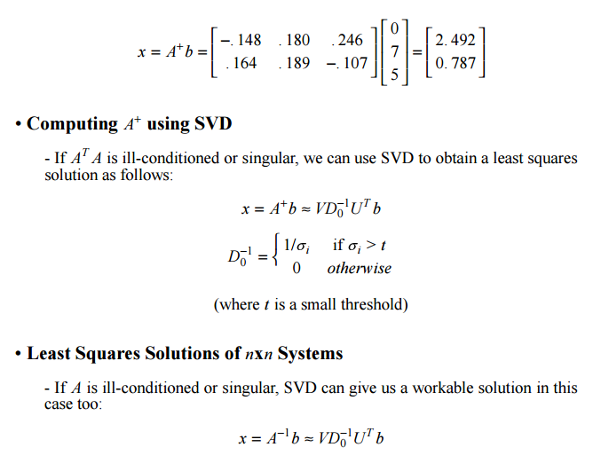
SVD application

